Slide 1

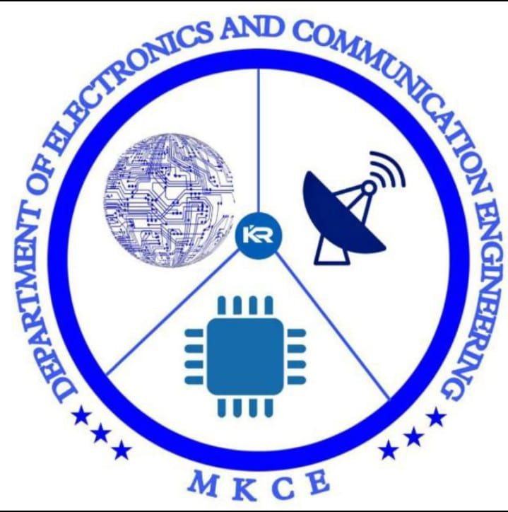

Smart water bottle
TEAM MEMBERS :
S.SOWMIYAA-927622BEC199
B.SOWMIYA-927622BEC196
S.VARSHINI-927622BEC241

Slide 2
OBJECTIVE:
The primary objective of the Smart Water Bottle project is to leverage technological advancements to enhance and revolutionize the way individuals approach hydration.
The project aims to create a sensor-equipped water bottle integrated with a sophisticated notification system, providing users with a holistic and personalized experience that goes beyond traditional water level indicators.
Smart water bottle is an innovative hydration device equipped with technology to track and enhance your water intake. It often includes features like hydration reminders, water temperature control, tracking apps, and sometimes even integration with fitness devices to monitor your hydration levels during workouts.

Slide 3
PROBLEM STATEMENT:
Due to busy schedules of humans and endless distractions, it’s hard to remember to drink
enough water by the humans. So, in order to build a healthy water drinking habit, it’s
important to track our water intake every day.
To serve this purpose the Smart Interactive Water Bottle will be of great
help. This Smart Interactive Water Bottle helps the user to track his daily
amount of water consumed, average amount of water consumed, last water
intake time and also alert the user reminding him to drink water.

Slide 4
BLOCK DIAGRAM:
RESET
OFF
NODE MCU
HIGH
MIDDLE
LED1
PCB BOARD
LED 2
LOW
LED 3

Slide 5
Working:
A smart water bottle typically includes sensors to track water consumption, and it may connect to a mobile app via Bluetooth or other wireless technology.
The sensors measure how much water is consumed, and the data is then sent to the app for analysis. Some smart bottles also provide reminders to stay hydrated and may sync with fitness trackers to provide a comprehensive health overview.
Most smart water bottles use Bluetooth or other wireless technologies to connect with a mobile app on a smartphone or other devices.
This connectivity allows real-time communication between the bottle and the app. Smart water bottles often come with a feature to send notifications or reminders to the user's phone.
These reminders prompt the user to drink water regularly, helping them stay hydrated throughout the day.

Slide 6
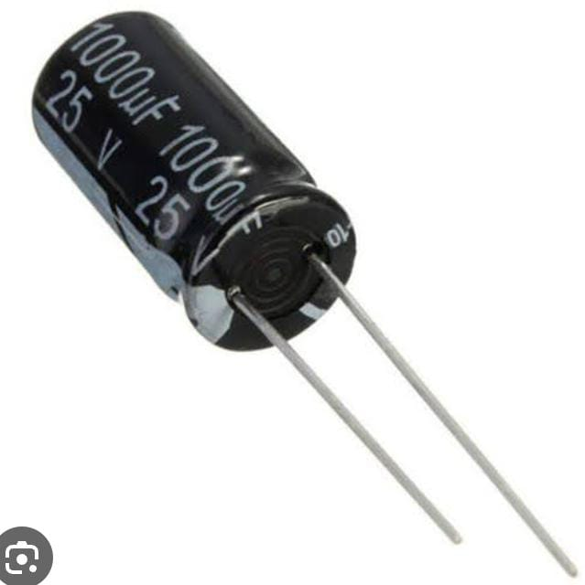
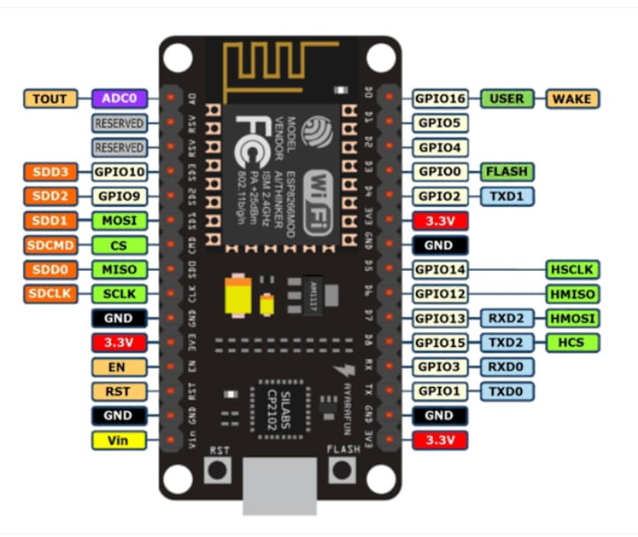
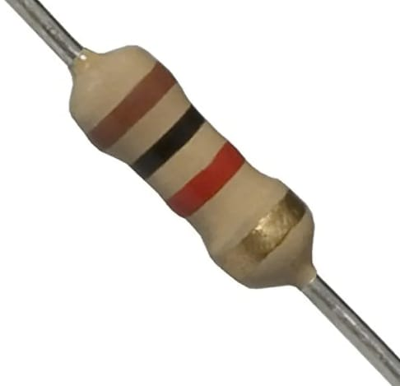
COMPONENTS :
Node MCU
7805 Regulator
Capacitor 1000mf
Transistor
LED
1K ,10K Resistor
PCB Board

Slide 7
NODE MCU:
NodeMCU is an open-source firmware and hardware development kit based on the
ESP8266 Wi-Fi module.
It allows for easy programming and deployment of IoT (Internet of Things) projects.
NodeMCU Dev Kit/board consist of ESP8266 wifi enabled chip. The ESP8266 is a low-cost
Wi-Fi chip developed by Espressif Systems with TCP/IP protocol.

Slide 8
EMBEDDED C PROGRAM:
Embedded C is most popular programming language in software field for developing electronic gadgets. Each processor used in electronic system is associated with embedded software.
we used many electronic devices such as mobile phone, washing machine, digital camera, etc. These all device working is based on microcontroller that are programmed by embedded C.
Embedded C programming typically requires nonstandard extensions to the C language in order to support enhanced microprocessor features such as fixed-point arithmetic, The extension of the C programming language is known as embedded C.

Slide 9
PCB Board:
A printed circuit board (PCB), also called printed wiring board (PWB), is a medium used to
connect or "wire" components to one another in a circuit.
Electrical components may be fixed to conductive pads on the outer layers in the shape
designed to accept the component's terminals, generally by means of soldering, to both
electrically connect and mechanically fasten them to it.

Slide 10
Conclusion:
In conclusion, smart water bottles seamlessly integrate technology into our hydration
routines, promoting a healthier lifestyle by providing real-time tracking, reminders, and
personalized insights.
With features like hydration reminders and tracking apps, these bottles strive to
enhance our overall well-being by making hydration both convenient and
mindful. As technology continues to advance, smart water bottles represent a promising
intersection of health and innovation in our daily lives.

Slide 11
Future scope:
Hydration History and Trends:
Expand the app to include a detailed history of hydration patterns, trends, and achievements. Users can track their progress over time and identify patterns that influence their water intake.
Voice Recognition:
Implement voice recognition technology to allow users to interact with the smart water bottle and the app using voice commands. This enhances accessibility and convenience, especially when users are on the go.

Slide 12
REFERENCES:
A. Al-Fuqaha, M. Guizani, M. Mohammadi, M. Aledhari, and M. Ayyash, "Internet of Things: A Survey on Enabling Technologies, Protocols, and Applications," IEEE Commun. Surv. Tutor., vol. 17, no. 4, pp. 2347-2376, Fourthquarter 2015.
C. Perera, A. Zaslavsky, P. Christen, and D. Georgakopoulos, "Context Aware Computing for The Internet of Things: A Survey," IEEE Commun. Surv. Tutor., vol. 16, no. 1, pp. 414-454, First 2014.
L. Hood, J. C. Lovejoy, and N. D. Price, "Integratingbig data and actionable health coaching to optimize wellness," BMC Med., vol. 13, p. 4, 2015.

Slide 13
THANK YOU

